Slide 1
Simple Interest
Year 11
Week 3
Lesson 2

Slide 2
Topic: Simple Interest
Date
EQ – How to find simple interest using the formula
What is Simple Interest?
Simple interest is a quick method of calculating the interest charge on a loan.

Slide 3
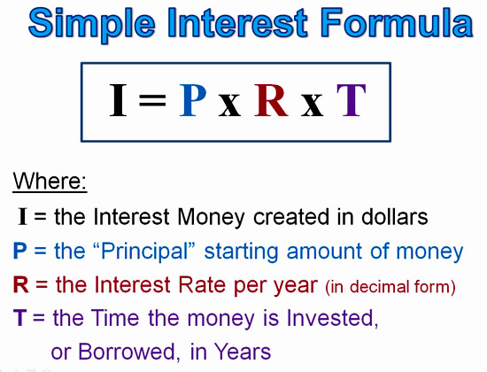
Topic: Simple Interest
Date
EQ – How to find simple interest using the formula
What is the Simple Interest Formula?

Slide 4
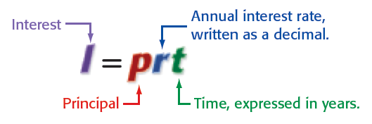
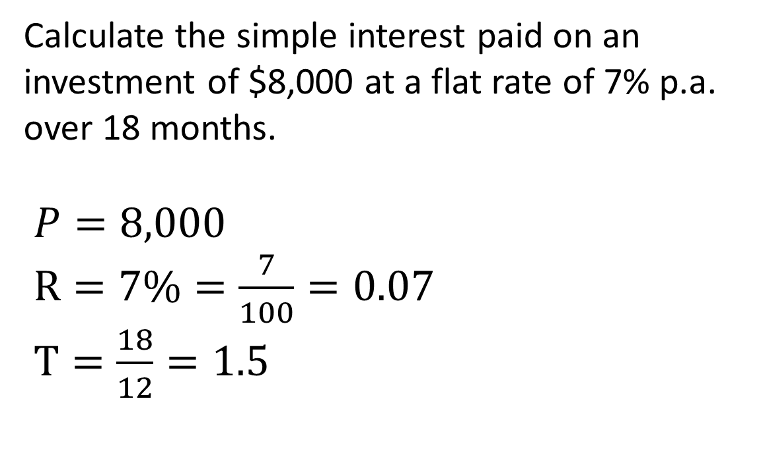
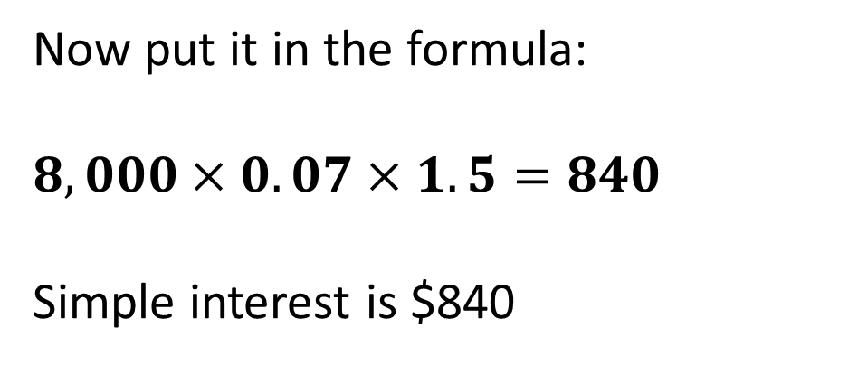
Topic: Simple Interest
Date
EQ – How to find simple interest using the formula
Example
Calculate the simple interest paid on an investment of $8,000 at a flat rate of 7% p.a. over 18 months.
$P=8,000$
$R=7\%=\frac{7}{100}=0.07$
$T=\frac{18}{12}=1.5$
Now put it in the formula:
$$8,000×0.07×1.5=840$$
Simple interest is $840

Slide 5
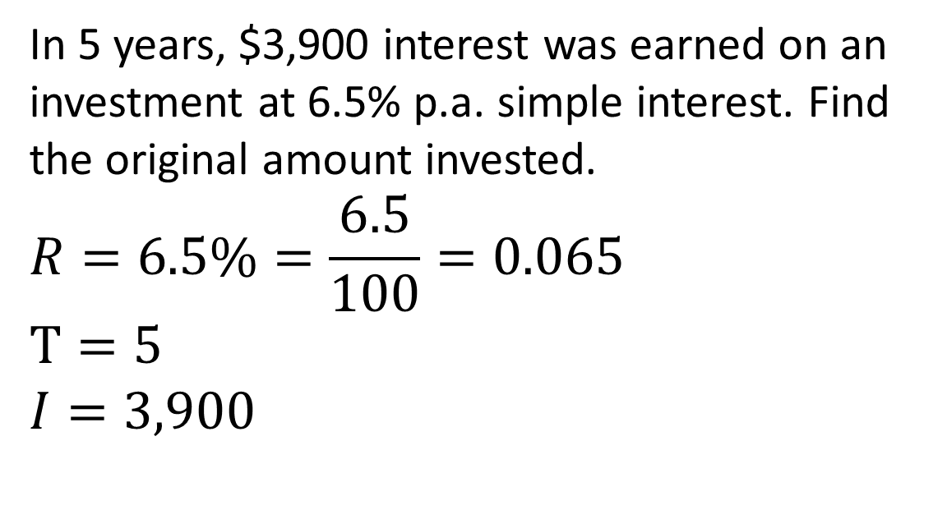
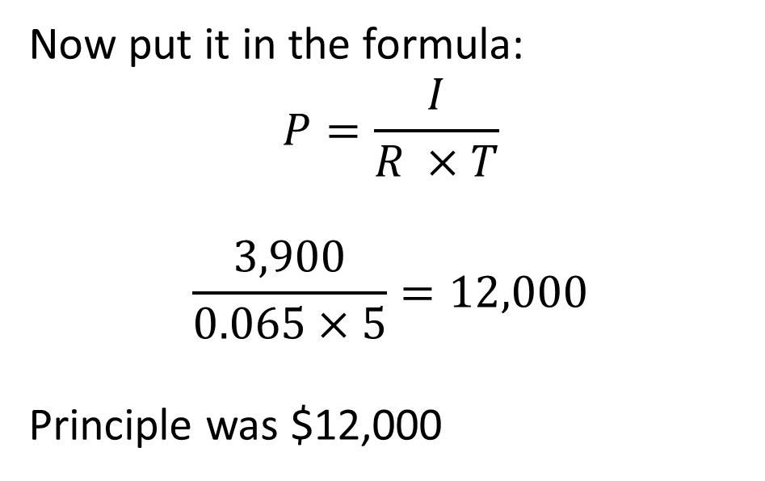
Topic: Simple Interest
Date
EQ – How to find simple interest using the formula
Example
In 5 years, $3,900 interest was earned on an investment at 6.5% p.a. simple interest. Find the original amount invested.
$$R=6.5\%=\frac{6.5}{100}=0.065$$
$$T=5$$
$$I=3,900$$
Now put it in the formula:
$$P=\frac{I}{R ×T}$$
$$\frac{3,900}{0.065×5}=12,000$$
Principle was $12,000

Slide 6
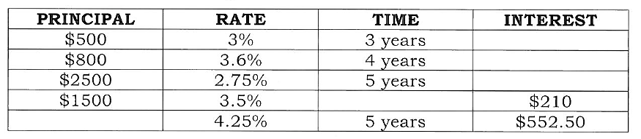
Calculate the interest earned for the following Principals:

